Slide 1
Welcome to Week 1
Calculus 1
https://ljr3.files.wordpress.com/2012/07/movement-2.jpg

Slide 2
Trigonometry?
What is trigonometry?

Slide 3
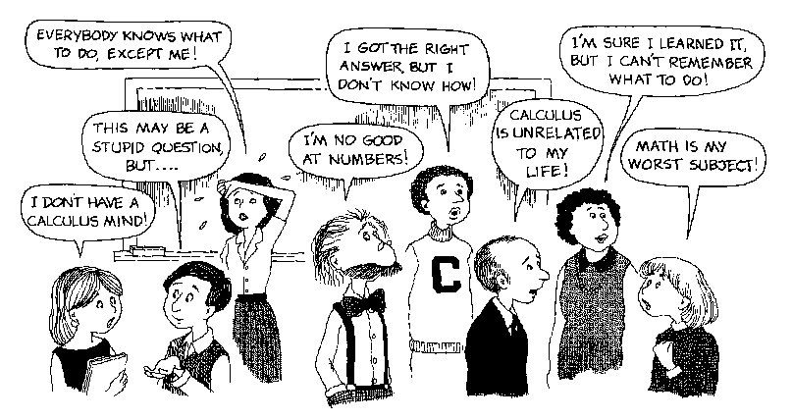
So… Howcum we have to take CALCULUS ???

Slide 4
What Is Calculus?

Slide 5
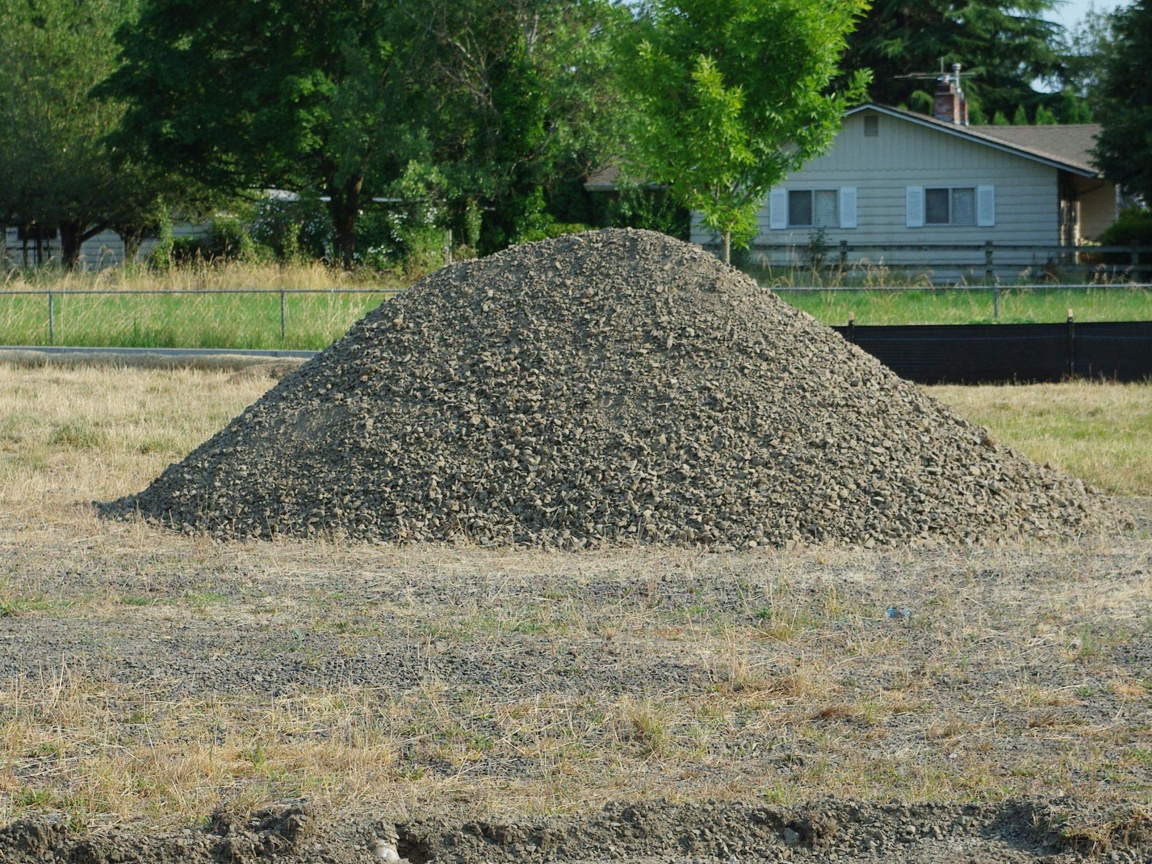
What Is Calculus?
Not just rocks…

Slide 6
CALCULUS
is the mathematics of CHANGE

Slide 7
Calculus - Functions
Given any value of “x”
there is only one value of “y”

Slide 8
Calculus - Functions
If a vertical line crosses a graph in more than one place, the graph is not a function
VERTICAL LINE TEST

Slide 9
CALCULUS - FUNCTIONS
IN-CLASS PROBLEMS
Which are functions:

Slide 10
Calculus - Functions
Evaluating a function –
plug in a value for “x” to
calculate “y”

Slide 11
CALCULUS - FUNCTIONS
IN-CLASS PROBLEMS
Calculate “y” for x = 5:
1) y = 10x 4) y = x
2) y = 4x + 3 5) 5) y = -7
3) y = -2x + 6 6) y = -x

Slide 12
CALCULUS - FUNCTIONS
IN-CLASS PROBLEMS
Calculate “y” for x = 5:
1) y = 50 4) y = 5
2) y = 23 5) y = -7
3) y = 4 6) y = -5

Slide 13
Calculus - Functions
Even functions are symmetric (mirror) across the y-axis

Slide 14
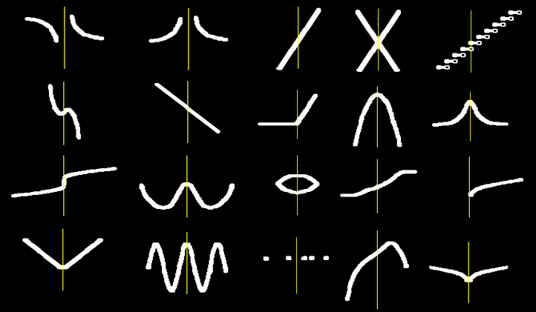
CALCULUS - FUNCTIONS
IN-CLASS PROBLEMS
Which are even?

Slide 15
Calculus - Functions
Odd functions must have double symmetry across the origin (0,0)

Slide 16
CALCULUS - FUNCTIONS
IN-CLASS PROBLEMS
Which are odd?

Slide 17
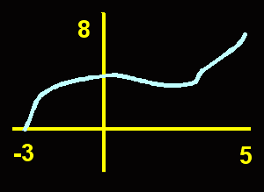
Calculus - Functions
The domain of a function is the values the x’s can have
(0,1) (7,5) (3,8) (10,23)

Slide 18
Calculus - Functions
The range of a function is the values the y’s can have
(0,1) (7,5) (3,8) (10,23)

Slide 19
Calculus - Functions
Set builder notation
{ x| x = 1, 7, 9}
{ y| y = 42, 68.1, 305}
{ x| a < x ≤ b }
{ y| c ≤ y < d }

Slide 20
Calculus - Functions
Interval notation
x = [1,4)
y = (7,69.203]
“(”or “)” means the exact value
is not included
“[” or “]” means the exact value
is included

Slide 21
Questions?

Slide 22
Calculus
Slope of a line
Traditionally designated “m”
Slope is the rise/run
or (y₁ - y₂)/(x₁ – x₂)

Slide 23
Calculus - ∆
New symbol!
∆ means “change”

Slide 24
Calculus - ∆
∆y means the change in y
∆x means the change in x

Slide 25
Calculus - ∆
So m = ∆y / ∆x

Slide 26
Calculus - ∆,d
“d” also means change
dy means the change in y
dx means the change in x
So m = dy / dx

Slide 27
Calculus - ∆,d
Δx = x_{final} - x_{initial}
= x₁ - x₀
Δy = y_{final} - y_{initial}
= y₁ - y₀

Slide 28
Calculus - ∆,d
An increment Δ is the final value minus the initial value

Slide 29
Calculus - ∆,d
An increment Δ is the final value minus the initial value
Δx (the change in x) = x_{final}-x_{initial}

Slide 30
Calculus - ∆,d
An increment Δ is the final value minus the initial value
Δx (the change in x) = x_{final}-x_{initial}
Δy (the change in y) = y_{final}-y_{initial}

Slide 31
Calculus - ∆,d
A positive increment means the quantity is increasing

Slide 32
Calculus - ∆,d
A negative increment means the quantity is decreasing

Slide 33
CALCULUS – Δ,d
IN-CLASS PROBLEMS
Increasing or decreasing?
Initial Value | 1 | 3 | 6 | -2 | -5
Final Value | 2 | 6 | 4 | 6 | -10

Slide 34
CALCULUS – Δ,d
IN-CLASS PROBLEMS
In-class project:
Draw a graph of your trip to
ITT today
Each x-tick is 1 minute
Each y-tick is 1 mile your feet,
bus or vehicle travelled

Slide 35
CALCULUS – Δ,d
IN-CLASS PROBLEMS
∆ position (distance you went)
d₁ – d₀
∆ time (time it took)
t₁ – t₀
Calculate your ∆location and
∆time

Slide 36
CALCULUS – Δ,d
IN-CLASS PROBLEMS
mph is:
mph = ∆position / ∆time = (d₁ – d₀)/(t₁ – t₀)
Calculate your mph

Slide 37
Calculus - ∆,d
This mph speed is an average value

Slide 38
Calculus - ∆,d
It is called the “average velocity”

Slide 39
Calculus - ∆,d
The velocity of an object is the rate of change of its position with respect to a frame of reference, and is a function of time

Slide 40
Calculus - ∆,d
At any instant in time, your speed would be a bit different from the average

Slide 41
Calculus - ∆,d
At any instant in time, your speed would be a bit different from the average
This is called your “instantaneous velocity”

Slide 42
CALCULUS – Δ,d
IN-CLASS PROBLEMS
The position (s) of an object (in inches) moving along a line is:
s(t) = -16t² + 128t
Find the average velocity over the time interval 1≤t≤2

Slide 43
CALCULUS – Δ,d
IN-CLASS PROBLEMS
s(t) = -16t² + 128t over [1,2]
First evaluate the function at the final value: 2
Then evaluate the function at the initial value: 1

Slide 44
CALCULUS – Δ,d
IN-CLASS PROBLEMS
s(t) = -16t² + 128t
evaluate the function at 2
s(2) = -16(2²) + 128(2)
= -64 + 256 = 192 inches

Slide 45
CALCULUS – Δ,d
IN-CLASS PROBLEMS
s(t) = -16t² + 128t
then evaluate the function at 1
s(1) = -16(1²) + 128(1)
= -16 + 128 = 112 inches

Slide 46
CALCULUS – Δ,d
IN-CLASS PROBLEMS
So, the change in location is:
∆location = s(final t) – s(first t)
= 192-112
= 80 inches

Slide 47
CALCULUS – Δ,d
IN-CLASS PROBLEMS
And the change in time is:
∆time = final t – first t
= 2-1
= 1 sec

Slide 48
CALCULUS – Δ,d
IN-CLASS PROBLEMS
So the average velocity:
∆location / ∆time
(s(final t) – s(first t))/(final t – first t)
In this case:
(192 – 112)/(2 - 1) = 80/1
= 80 in/sec

Slide 49
CALCULUS – Δ,d
IN-CLASS PROBLEMS
The position (s) of an object moving along a line is:
s(t) = -16t² + 128t
Find the average velocity over the interval 1≤t≤1.5

Slide 50
CALCULUS – Δ,d
IN-CLASS PROBLEMS
For: s(t) = -16t² + 128t
find the average velocity over the interval 1≤t≤1.5
Time Interval | [1,2] | [1,1.5] | [1,1.1] | [1,1.01] | [1,1.001]
ΔPosition | 80 in
ΔTime | 1 sec
Average Velocity | 80 in/sec

Slide 51
CALCULUS – Δ,d
IN-CLASS PROBLEMS
For: s(t) = -16t² + 128t
find the average velocity over the interval 1≤t≤1.5
Time Interval | [1,2] | [1,1.5] | [1,1.1] | [1,1.01] | [1,1.001]
ΔPosition | 80 in | 156-112 =44 in
ΔTime | 1 sec | 0.5 sec
Average Velocity | 80 in/sec | 88 in/sec

Slide 52
CALCULUS – Δ,d
IN-CLASS PROBLEMS
For: s(t) = -16t² + 128t
find the average velocity over the interval 1≤t≤1.5
Time Interval | [1,2] | [1,1.5] | [1,1.1] | [1,1.01] | [1,1.001]
ΔPosition | 80 in | 156-112 =44 in | 121-112 ≈9.4in
ΔTime | 1 sec | 0.5 sec | 0.1 sec
Average Velocity | 80 in/sec | 88 in/sec | 94.4 in/sec

Slide 53
CALCULUS – Δ,d
IN-CLASS PROBLEMS
For: s(t) = -16t² + 128t
find the average velocity over the interval 1≤t≤1.5
Time Interval | [1,2] | [1,1.5] | [1,1.1] | [1,1.01] | [1,1.001]
ΔPosition | 80 in | 156-112 =44 in | 121-112 ≈9.4in | 113-112 ≈1 in
ΔTime | 1 sec | 0.5 sec | 0.1 sec | 0.01 sec
Average Velocity | 80 in/sec | 88 in/sec | 94.4 in/sec | 95.8 in/sec

Slide 54
CALCULUS – Δ,d
IN-CLASS PROBLEMS
For: s(t) = -16t² + 128t
find the average velocity over the interval 1≤t≤1.5
Time Interval | [1,2] | [1,1.5] | [1,1.1] | [1,1.01] | [1,1.001]
ΔPosition | 80 in | 156-112 =44 in | 121-112 ≈9.4in | 113-112 ≈1 in | 112.1-112 ≈0.1 in
ΔTime | 1 sec | 0.5 sec | 0.1 sec | 0.01 sec | 0.001 sec
Average Velocity | 80 in/sec | 88 in/sec | 94.4 in/sec | 95.8 in/sec | 95.98 in/sec

Slide 55
Questions?

Slide 56
Remember Trig?
A tangent (tan) is the sin/cos

Slide 57
Remember Trig?
A tangent (tan) is the sin/cos
A sin in a unit circle is the rise
(Δy)

Slide 58
Remember Trig?
A tangent (tan) is the sin/cos
A sin in a unit circle is the rise
(Δy)
A cos in a unit circle is the run
(Δx)

Slide 59
Remember Trig?
A tangent (tan) is the sin/cos
A sin in a unit circle is the rise
A cos in a unit circle is the run
SO a tangent is a slope:
rise/run

Slide 60
Remember Trig?
A tangent (tan) is the sin/cos
A sin in a unit circle is the rise
A cos in a unit circle is the run
SO a tangent is a slope:
rise/run
Δy/Δx

Slide 61
Remember Trig?
And a tangent Δy/Δx is a ratio of two changes

Slide 62
Remember Trig?
So the average velocity:
∆location / ∆time
(s(final t) – s(first t))/(final t – first t)
is a tangent Δy/Δx !!!!

Slide 63
Remember Trig?
AND a “tangent” is also the line tangent to the unit circle at the point where the right triangle intersects the circle

Slide 64
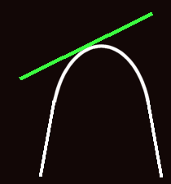
Remember Trig?
In fact, a “tangent” is the line tangent to any graph at a given point

Slide 65
Remember Trig?
The line joining any two points on a curve is the “secant”

Slide 66
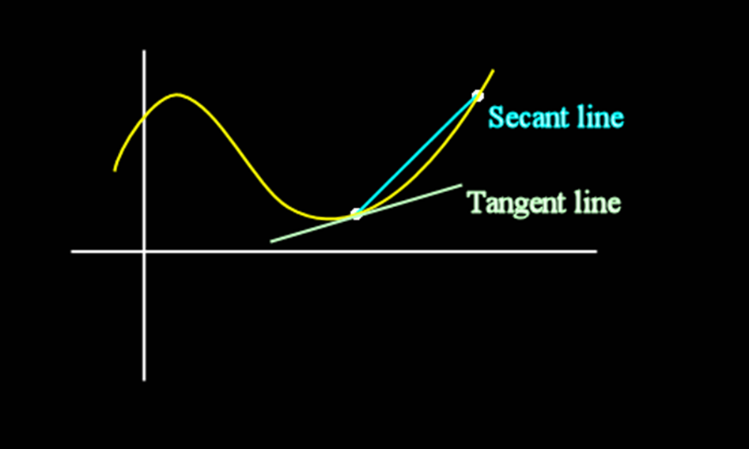
Remember Trig?
secant vs tangent:

Slide 67
Remember Trig?
The slope of the secant line is:
m_{sec} = ∆y / ∆x

Slide 68
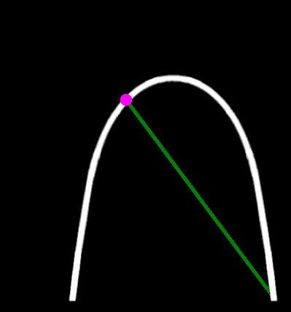
Remember Trig?
Limits:
As you move a secant line up the curve

Slide 69
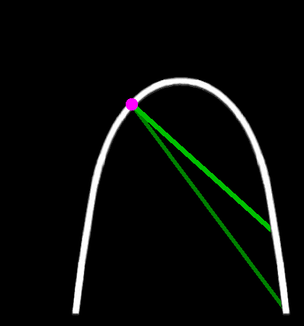
Remember Trig?
Limits:
As you move a secant line up the curve

Slide 70
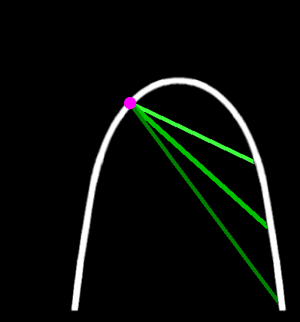
Remember Trig?
Limits:
As you move a secant line up the curve

Slide 71
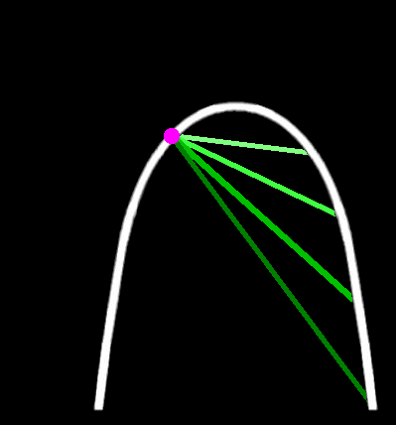
Remember Trig?
Limits:
As you move a secant line up the curve

Slide 72
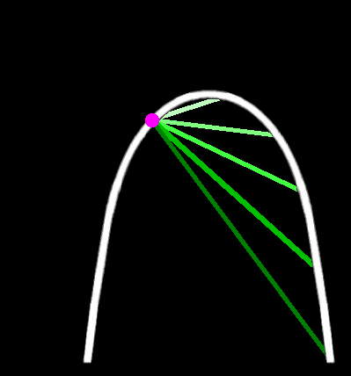
Remember Trig?
Limits:
As you move a secant line up the curve

Slide 73
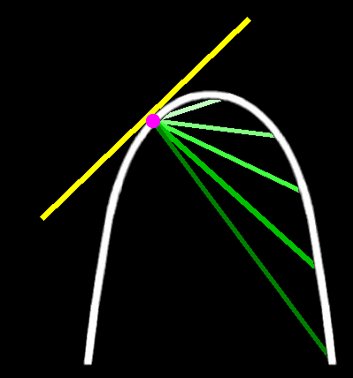
Remember Trig?
Limits:
It becomes a tangent when it hits the point on the curve

Slide 74
Another Way to Look at It
Pick any secant
Move the secant closer and
closer to one of its endpoints
When it touches the endpoint,
it becomes the tangent

Slide 75
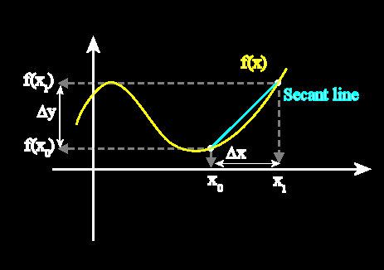
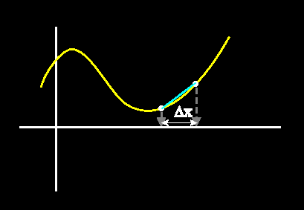
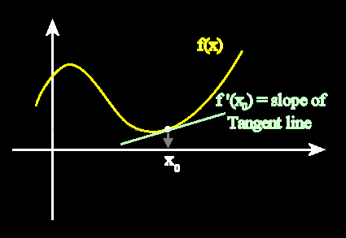
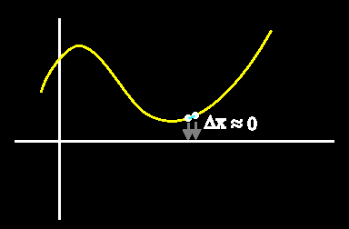
Another Way to Look at It
http://clas.sa.ucsb.edu/staff/lee/secant,%20tangent,%20and%20derivatives.htm

Slide 76
Remember Trig?
So, a tangent is the limit of any line you draw through a graph at a given point

Slide 77
Questions?

Slide 78
Limits
Asymptotes get closer and closer to a value, but never actually get there

Slide 79
Limits
“(”or “)” in interval notation means you get closer and closer to the exact value, but you never actually get there

Slide 80
Limits
This concept of getting closer and closer to a value or a location on a graph is called a
taking a “limit”

Slide 81
Limits
asymptote = limit

Slide 82
LIMITS
IN-CLASS PROBLEMS
What would you estimate the limits to be for this table of data?
Time Interval | Change in Time | Average Velocity
[1,2] | 2 – 1 = 1 sec | 48 ft/sec
[1,1.5] | 1.5 – 1 = 0.5 sec | 56 ft/sec
[1,1.1] | 1.1 – 1 = 0.1 sec | 62.4 ft/sec
[1,1.01] | 1.01 – 1 = 0.01 sec | 63.84 ft/sec
[1,1.001] | 1.001 – 1 = 0.001 sec | 63.984 ft/sec
[1,1.0001] | 1.0001 – 1 = 0.0001 sec | 63.9984 ft/sec

Slide 83
Limits
As the Change in Time is
getting closer and closer to:
1 – 1 = 0 time
The Average Velocity is getting
closer and closer to:
64 ft/sec

Slide 84
Limits
We write this as:
lim = 64
change in time →0
or:
lim = 64
Δtime →0

Slide 85
Limits
An instantaneous velocity
is a limit

Slide 86
LIMITS
IN-CLASS PROBLEMS
What would you estimate your instantaneous velocity would be at t=2?
Time Interval | [2,3] | [2,2.5] | [2,2.1] | [2,2.01] | [2,2.001]
Average Velocity | 22.4682 mph | 23.7187 mph | 24.5307 mph | 24.9851 mph | 24.9936 mph

Slide 87
LIMITS
IN-CLASS PROBLEMS
What would you estimate your instantaneous velocity would be at t=2?
Think of this as the velocity between time “2” and time “2”
Time Interval | [2,3] | [2,2.5] | [2,2.1] | [2,2.01] | [2,2.001]
Average Velocity | 22.4682 mph | 23.7187 mph | 24.5307 mph | 24.9851 mph | 24.9936 mph

Slide 88
LIMITS
IN-CLASS PROBLEMS
What would you estimate your instantaneous velocity would be at t=2?
An “instantaneous” velocity!
Time Interval | [2,3] | [2,2.5] | [2,2.1] | [2,2.01] | [2,2.001]
Average Velocity | 22.4682 mph | 23.7187 mph | 24.5307 mph | 24.9851 mph | 24.9936 mph

Slide 89
LIMITS
IN-CLASS PROBLEMS
What would you estimate your instantaneous velocity would be at t=2?
The instantaneous velocity is?
Time Interval | [2,3] | [2,2.5] | [2,2.1] | [2,2.01] | [2,2.001]
Average Velocity | 22.4682 mph | 23.7187 mph | 24.5307 mph | 24.9851 mph | 24.9936 mph

Slide 90
LIMITS
IN-CLASS PROBLEMS
What would you estimate your instantaneous velocity would be at t=2?
The instantaneous velocity is
25 mph
Time Interval | [2,3] | [2,2.5] | [2,2.1] | [2,2.01] | [2,2.001]
Average Velocity | 22.4682 mph | 23.7187 mph | 24.5307 mph | 24.9851 mph | 24.9936 mph

Slide 91
LIMITS
IN-CLASS PROBLEMS
Suppose you had a position function: s(t) = -16t² + 128t
What would you estimate your instantaneous velocity would be at t=1?

Slide 92
LIMITS
IN-CLASS PROBLEMS
For: s(t) = -16t² + 128t
find the instantaneous velocity at t=1
Time Interval | [1,2] | [1,1.5] | [1,1.1] | [1,1.01] | [1,1.001]
ΔPosition | 80 in | 156-112 =44 in | 121-112 ≈9.4in | 113-112 ≈1 in | 112.1-112 ≈0.1 in
ΔTime | 1 sec | 0.5 sec | 0.1 sec | 0.01 sec | 0.001 sec
Average Velocity | 80 in/sec | 88 in/sec | 94.4 in/sec | 95.8 in/sec | 95.98 in/sec

Slide 93
LIMITS
IN-CLASS PROBLEMS
For: s(t) = -16t² + 128t
find the instantaneous velocity at t=1
What is the instantaneous velocity?
Time Interval | [1,2] | [1,1.5] | [1,1.1] | [1,1.01] | [1,1.001]
Average Velocity | 80 in/sec | 88 in/sec | 94.4 in/sec | 95.8 in/sec | 95.98 in/sec

Slide 94
Everyday Instantaneous Velocity
Any examples?

Slide 95
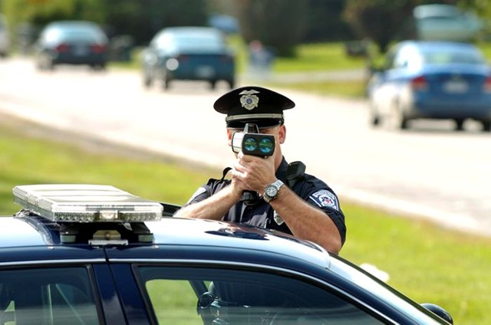
Everyday Instantaneous Velocity
watchdog.org

Slide 96
Everyday Instantaneous Velocity
Heisenberg’s Uncertainty Principle
Δp_{x} Δx ≥ ħ/2
Δx = uncertainty in position
Δp_{x} = uncertainty in momentum
ΔE Δt ≥ ħ/2
ΔE = uncertainty in energy
Δt = uncertainty in time

Slide 97
Everyday Instantaneous Velocity
Momentum is the product of
the mass and velocity
(speed and direction) of an
object
Quantified in foot-pounds per
second

Slide 98
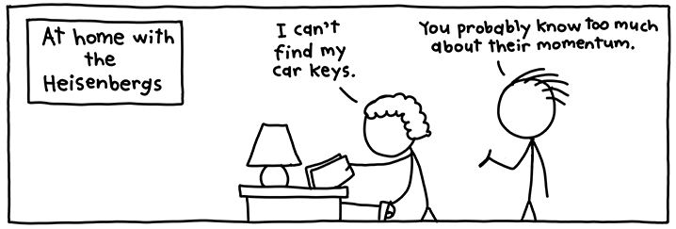
Everyday Instantaneous Velocity
https://interhacker.files.wordpress.com/2015/03/chickens.png

Slide 99
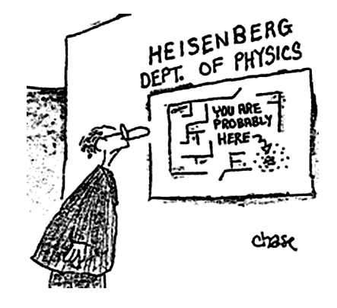
Everyday Instantaneous Velocity
http://images.slideplayer.com/2/765091/slides/slide_2.jpg

Slide 100
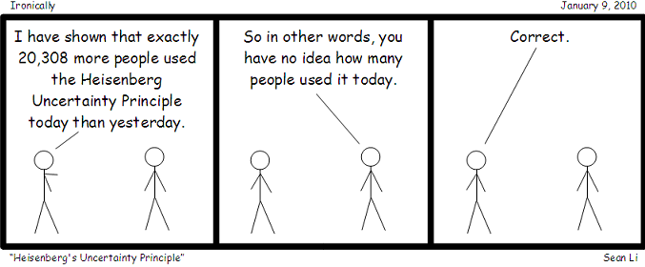
Everyday Instantaneous Velocity
https://nargaque.files.wordpress.com/2009/12/heisenbergsuncertaintyprinciple.png

Slide 101
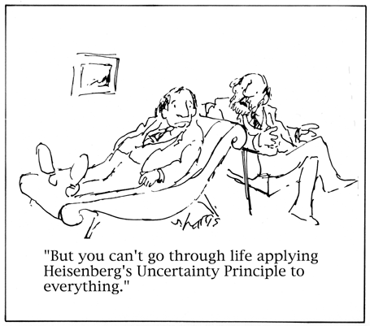
Everyday Instantaneous Velocity
http://1.bp.blogspot.com/-5gtcelh2rHY/TdTrq1ufEjI/AAAAAAAAAXQ/2RYehS5K4Ec/s1600/Heisenberg.gif

Slide 102
Questions?

